Slide 1





PPMC
Presentation
About PME
Group 3
Sea Wolves

Slide 2
o1
How did you rank the
objectives TCQ and did
these change during
the project?

Slide 3
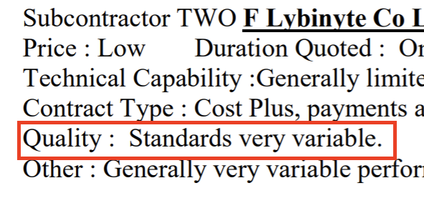
TCQ
01
Time & Cost & Quality
TIME
COST
QUALITY
1
2
3
7 periods
140 days
Target Profit £200k
Estimated Profit £135k
Notes:
Firstly, regarding time management: We always place time as our top priority. Although we initially believed that cost and quality were equally important, due to budget overruns, we prioritized cost over quality in actual operations.
Changes during the process: There was a period when we estimated that we had sufficient time, so we focused more on controlling costs. However, due to the emergence of uncontrollable risks during the project, such as the extension of the D109 project timeline from 55 days to 100 days, we gradually realized that we must prioritize time.
首先，关于时间管理： 我们始终将时间放在第一位，虽然一开始我们认为成本与质量同样重要，但由于预算超支，实际操作中我们将成本优先于质量。
过程中的改变：中间有一段过程，因为我们计算到我们时间足够充足，所以更多地精力放在控制成本上，但是由于项目过程中不可控的风险出现，比如: 例如D109项目的时间延长，从55天增加到100天，我们逐渐认识到必须优先考虑时间。

Slide 4
o2
Include your risk register in
your presentation from last Monday’s session.
How well did you manage
these risks?
Which risks did you miss?

Slide 5
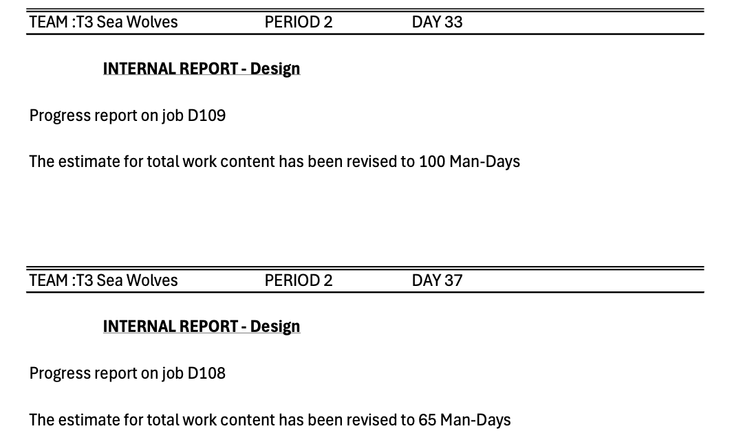
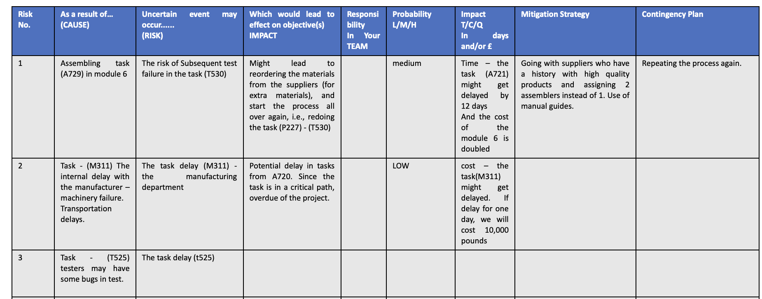
RISK
02
Expected risks & Actual risks
Notes:
Secondly, regarding the risks we encountered and our responses:
In the A729 project, we faced risks that prevented us from completing the project on time, leading to the decision to switch to a higher-quality but more expensive supplier.
Risks we overlooked during the process:
We failed to foresee the delays caused by the extended work of the designer.
The P214 supplier was unable to fulfill the order, forcing us to switch to a higher-cost supplier, which increased overall costs and reduced profits. This was beyond our control and posed a significant risk that led to project delays.
其次，关于我们遇见的风险和应对方法
一、 我们在A729项目中遇到风险，导致无法按时完成，最终决定更换为质量更高但成本更高的供应商。
过程中我们忽略的risk：
一、在此过程中，我们未能预见designer work的延长导致的延期。
二、P214供应商无法满足上述订单,导致我们必须换更高成本的供应商，从而增加整体成本并减少利润，但这是无法控制的，这就是很大的risk，导致我们项目延期 。

Slide 6
o3
What was your strategy
when choosing suppliers
and subcontractors.

Slide 7
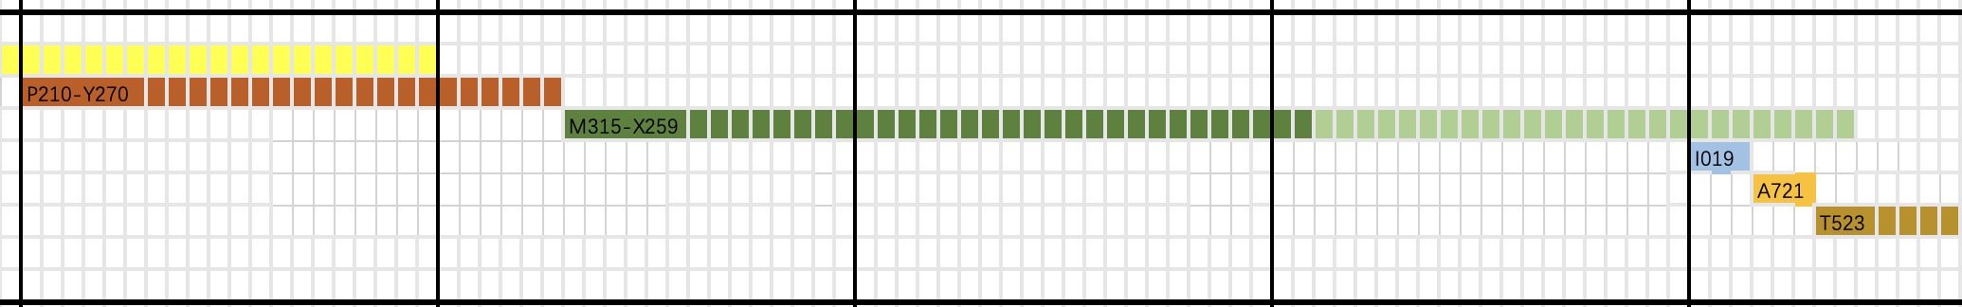
STRATEGY
03
Suppliers & subcontractors
Module5: Critical Path
Notes:
Regarding the strategy for selecting suppliers and contractors: When choosing suppliers on the critical path, we prioritize time. For non-critical paths, we focus more on cost and quality.
关于供应商和承包商选择的策略： 在选择关键路径上的供应商时，我们优先考虑时间。而在非关键路径上，我们则更多关注成本和质量。

Slide 8
o4
Compare plan and outcome. What went well?
What could have been done better?

Slide 9
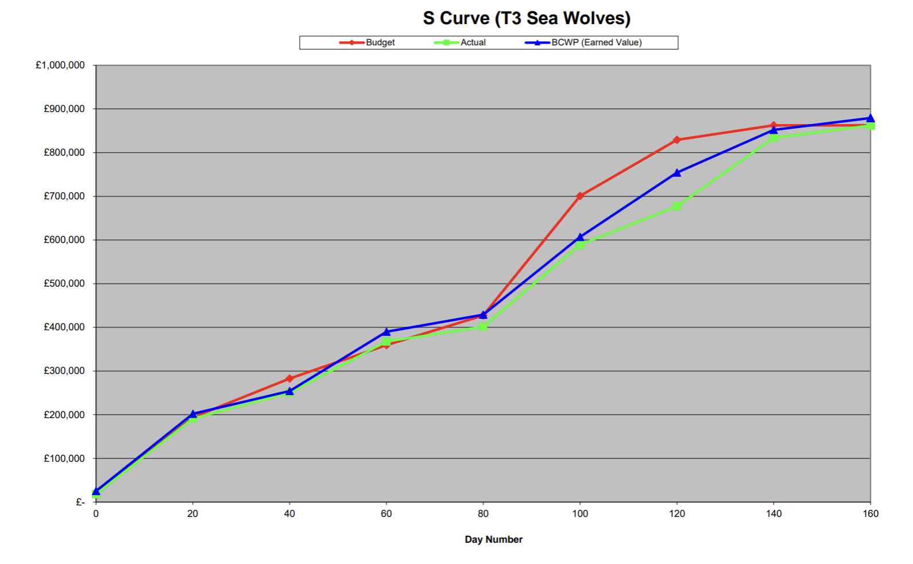
RESULT
04
Plan & Otucome
Notes:
Comparison of Our Plan and Outcome:
Plan: Expected profit of approximately 130k within the specified time frame.
Outcome: The project was delayed by 5 days, with actual profit around 87k.
How We Can Improve in Risk Management:
Risk Identification: We need to improve our risk identification process. Specifically, we should focus on recognizing delays as potential risks, not just the risk of outright failure. Our risk quantification was too conservative.
Resource Allocation:
Initial Resource Allocation: In our initial resource allocation, we didn’t align resources with task priorities. This misalignment led to inefficient resource flow, causing delays and wasted time.
Areas That Went Smoothly:
Although our final profit was significantly reduced due to the delay, the Actual performance, as shown in the above chart, was slightly better than the Plan.
比较我们的计划和结果：
计划： 在规定时间内，利润约130k。
结果： 实际中时间超期5天，利润约87k。
我们在风险管理上怎么做得更好：
第一方面：风险识别应该做得更好，我们需要更好地识别风险，尤其是延期风险，而不仅仅是失败风险，对于风险量化过于保守。
资源分配：
第二方面： 我们第一次确定资源分配数量的时候，并没有和优先级一一对应，导致资源流动未按照预期到规定的任务执行，造成了时间的浪费。
哪些方面进行到顺利：
虽然，我们的最终利润因为超时间所以扣了很多，比预期低
但是由上图所示Actual比我plan的表现略好。

Slide 10
o5
How were you organised in
the team, who did what?

Slide 11
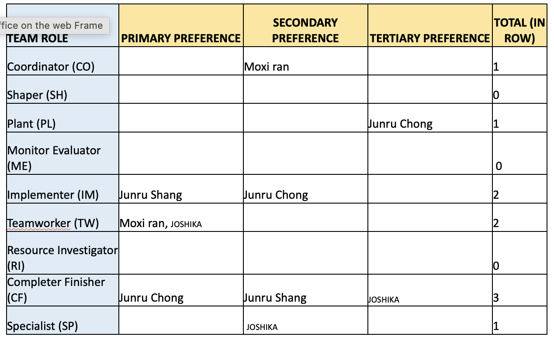
TEAM
05
Group Members & Teamwork
Notes:
Finally, Regarding Team Allocation:
We used the Belbin personality traits test to understand the strengths and weaknesses of our team members, allowing for a rational task allocation. The specific roles were assigned as follows:
Joshika: Primarily responsible for time estimation and cost control.
Shang: Focused on research and analysis for supplier selection.
Zhong: Mainly responsible for updating and adjusting the Gantt chart throughout the process.
Ran: Oversaw project monitoring, progress, and time management.
Additionally, our team lacked a "Monitor Evaluator," so decisions were made collectively through group discussions.
最后，关于团队分配： 我们使用Belbin性格特征测试来了解团队成员的优势与劣势，从而进行合理的任务分配。具体分配如下：
Joshika：主要负责计算时间和把控成本。
Shang: 主要负责不同资料寻找和分析供应商的选择 。
Chong： 主要负责调整进程中的甘特 图。
Ran： 主要负责整体监控、推进项目，把控时间。
除此之外，我们团队缺乏monitor evaluator，因此我们的决策都是通过集体讨论形成的。

Slide 12
Report is
completed
Thanks

